Slide 1
Dialogue Systems
CS 662
Jonathan May
Slides from Jurafsky, Mrkšić

Slide 2
Conversation Is Special
It's the prime way we use language
It's the oldest way we use language
It's the prime way we learn language
Being able to have a conversation is in a sense what makes us human

Slide 3
Every Use of Language Technology is a Threat to Conversation
"Social media is alienating and robs us of our humanity. What about real friends?"
"Don't email your mother, call her"
"No playing video games/watching television/listening to the radio/reading books at the dinner table. Tell me about your day"
"[Writing] will create forgetfulness in the learners’ souls, because they will not use their memories; they will trust to the external written characters and not remember of themselves. " – The Phaedrus (Plato, discussing Socrates), 895 AD

Slide 4




Conversational Agents AKA Dialog Agents
Phone-based Personal Assistants
SIRI, Alexa, Cortana, Google Assistant
Talking to your car
Communicating with robots
Clinical uses for mental health
Chatting for fun

Slide 5
Divide The World
(Goal-based) Dialog agents
SIRI, interfaces to cars, robots,
booking flights or restaurants
(No goal) Chatbots
The word "chatbots" is sometimes used in the popular press for both. We'll use it only for #2.

Slide 6
Frame-based dialog agents
Sometimes called "task-based dialog agents"
Based on a "domain ontology"
A knowledge structure representing user intentions
One or more frames
Each a collection of slots
Each slot having a value

Slide 7
Breakdown of the Task
Domain classification
Asking weather? Booking a flight? Programming alarm clock?
Intent Determination
Find a Movie, Show Flight, Remove Calendar Appt
Slot Filling
Extract the actual slots and fillers

Slide 8
The Frame
A set of slots, to be filled with information of a given type
Each associated with a question to the user
Slot Type Question
ORIGIN city What city are you leaving from?
DEST city Where are you going?
DEP DATE date What day would you like to leave?
DEP TIME time What time would you like to leave?
AIRLINE line What is your preferred airline?

Slide 9
Frame-based dialogue agents
1977:
Still the industrial state of the art
SIRI based on GUS architecture
Artificial Intelligence Journal, 1977

Slide 10
The state of the art in 1977 !!!!

Slide 11
Not super general (emphasis mine)
From abstract: "GUS (Genial Understander System) is intended to engage a sympathetic and highly cooperative human in an English dialog, directed towards a specific goal within a very restricted domain of discourse. As a starting point, GUS was restricted to the role of a travel agent in a conversation with a client who wants to make a simple return trip to a single city in California. "

Slide 12
Control structure for frame-based dialog
Consider a trivial airline travel system:
Ask the user for a departure city
Ask for a destination city
Ask for a time
Ask whether the trip is round-trip or not

Slide 13
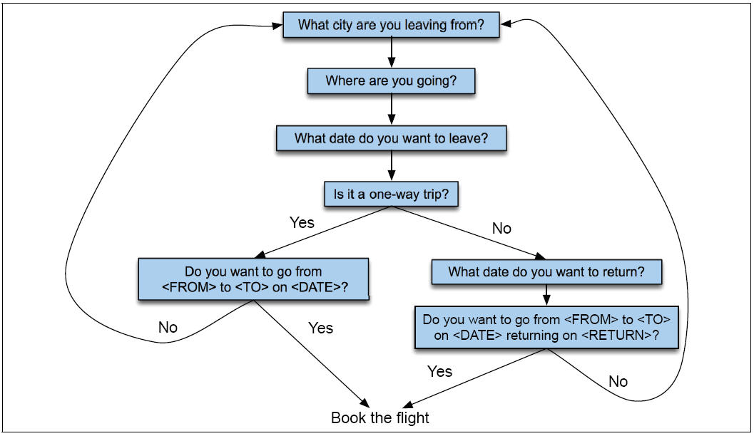
Finite State Dialog Manager

Slide 14
(Full Version...too much detail in general)

Slide 15
Finite-state dialog managers
System completely controls the conversation with the user.
It asks the user a series of questions
Ignoring (or misinterpreting) anything the user says that is not a direct answer to the system’s questions

Slide 16
Dialogue Initiative
Systems that control conversation like this are called single initiative.
Initiative: who has control of conversation
In normal human-human dialogue, initiative shifts back and forth between participants.

Slide 17
System Initiative
System completely controls the conversation
Simple to build
User always knows what they can say next
System always knows what user can say next
Known words: Better performance from ASR
Known topic: Better performance from NLU
OK for VERY simple tasks (entering a credit card, or login name and password)
Too limited
+
-

Slide 18
Problems with System Initiative
Real dialogue involves give and take!
In travel planning, users might want to say something that is not the direct answer to the question.
For example answering more than one question in a sentence:
Hi, I’d like to fly from Seattle Tuesday morning
I want a flight from Milwaukee to Orlando one way leaving after 5 p.m. on Wednesday.

Slide 19
Single initiative + universals
We can give users a little more flexibility by adding universals: commands you can say anywhere
As if we augmented every state of FSA with these
Help
Start over
Correct
This describes many implemented systems
But still doesn’t allow user much flexibility

Slide 21
Instead, the GUS architecture
A kind of mixed initiative
The conversational initiative shifts between system and user
The structure of the frame guides dialogue

Slide 22
Frames are mixed-initiative
System asks questions of user, filling any slots that user specifies
When frame is filled, do database query
If user answers 3 questions at once, system can fill 3 slots and not ask these questions again!

Slide 23
Natural Language Understanding for filling slots
Show me morning flights from Boston to SF on Tuesday.

Slide 24
Natural Language Understanding for filling slots
Wake me tomorrow at six.

Slide 25
Rule-based Slot-filling
Write regular expressions or grammar rules
Wake me (up) | set (the|an) alarm | get me up
Do text normalization ("tomorrow evening at 6" -> "18:00")

Slide 26
Siri uses GUS architecture (as far as I know): Condition-Action Rules
Active Ontology: relational network of concepts
data structures: a meeting has
a date and time,
a location,
a topic
a list of attendees
rule sets that perform actions for concepts
the date concept turns string
Monday at 2pm into
date object date(DAY,MONTH,YEAR,HOURS,MINUTES)

Slide 27
Rule sets
Collections of rules consisting of:
condition
action
When user input is processed, facts added to store and
rule conditions are evaluated
relevant actions executed

Slide 28
Part of ontology for meeting task
has-a
may-have-a
meeting concept: if you don’t yet have a location, ask for a location

Slide 29
Machine learning for slot-filling:
Machine learning classifiers to map words to semantic frame-fillers
Given a set of labeled sentences
“I want to fly to San Francisco on Tuesday”
Destination: SF
Depart-date: Tuesday
Build a classifier to map from one to the author
Requirements: Lots of labeled data

Slide 30
Machine learning for slot-filling: Slot presence
I want to fly to San Francisco on Monday afternoon please
Use 1-of-N classifier (naive bayes, logistic regression, neural network, etc.)
Input:
features like word N-grams, gazetteers (lists of cities)
Output:
Destination-City

Slide 31
Machine learning for slot-filling: Slot filler
I want to fly to San Francisco on Monday afternoon please
Use 1-of-N classifier (naive bayes, logistic regression, neural network, etc.) for Destination City
Input:
features like word N-grams, gazetteers (lists of cities)
Output:
San Francisco

Slide 32
More sophisticated algorithm for slot filling: IOB Tagging (cf: NER lectures)
IOB Tagging
tag for the beginning (B) and inside (I) of each slot label,
plus one for tokens outside (O) any slot label.
2n + 1 tags, where n is the number of slots.
B-DESTINASTION
I-DESTINATION
B-DEPART_TIME
I-DEPART_TIME
O

Slide 33
More sophisticated algorithm for slot filling: IOB Tagging
IOB Tagging is done by a sequence model
Typical:
Extracted strings can then be normalized (San Fran->SFO)

Slide 34
GUS: Still pretty passive
GUS wants to fill slots
What if you stop filling slots and try to ask a question?

Slide 35
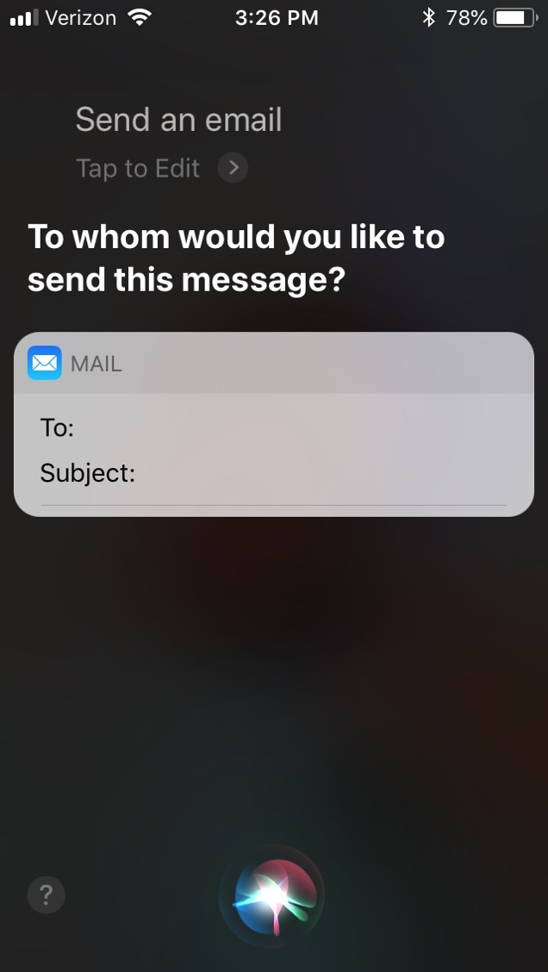
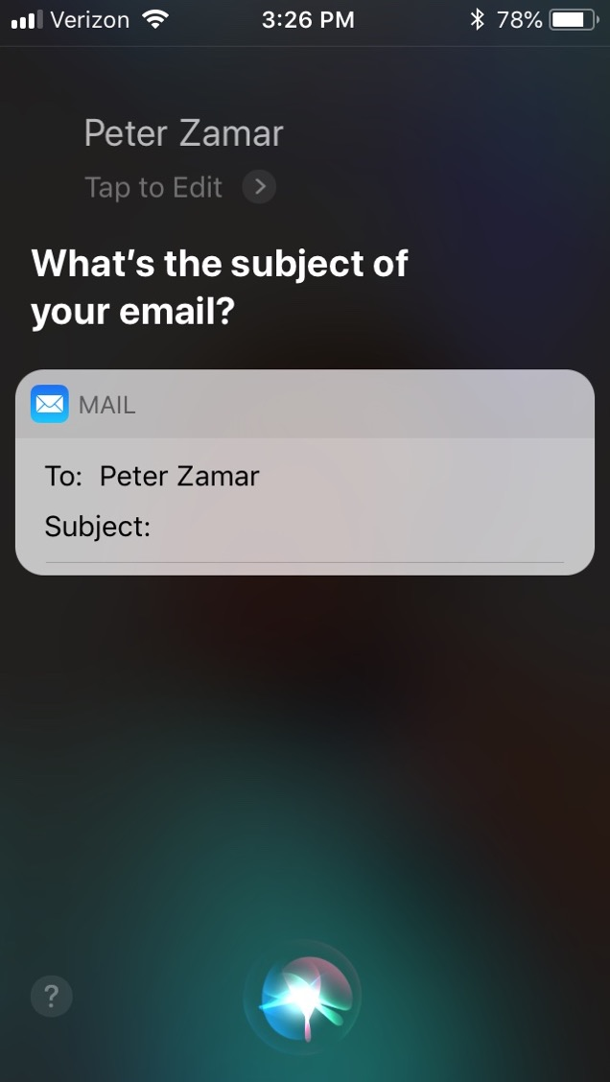

Slide 36
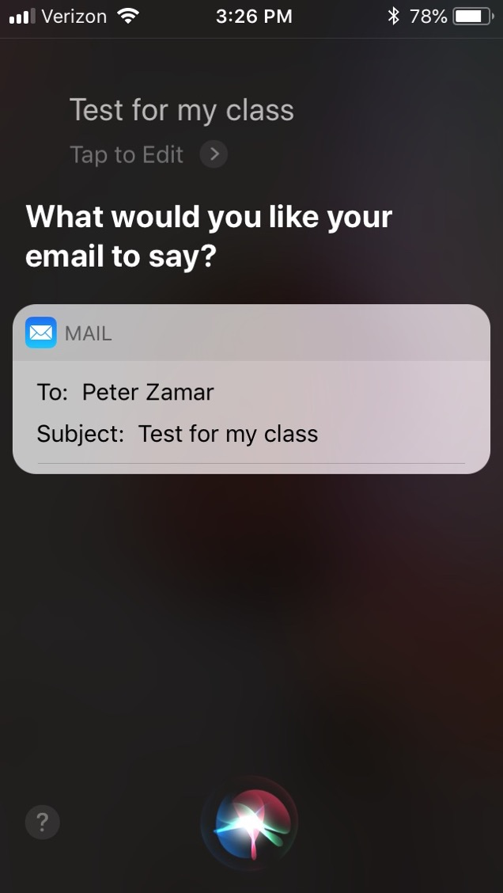
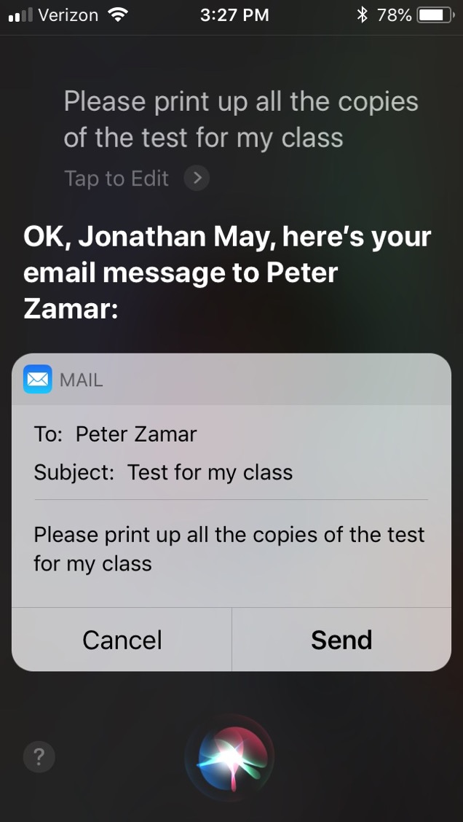

Slide 37
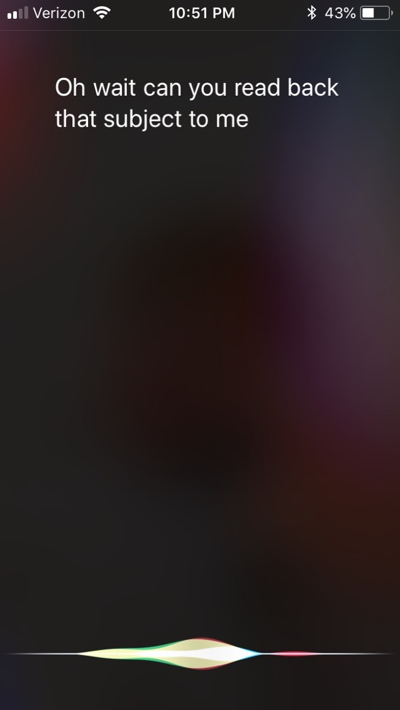

Slide 38
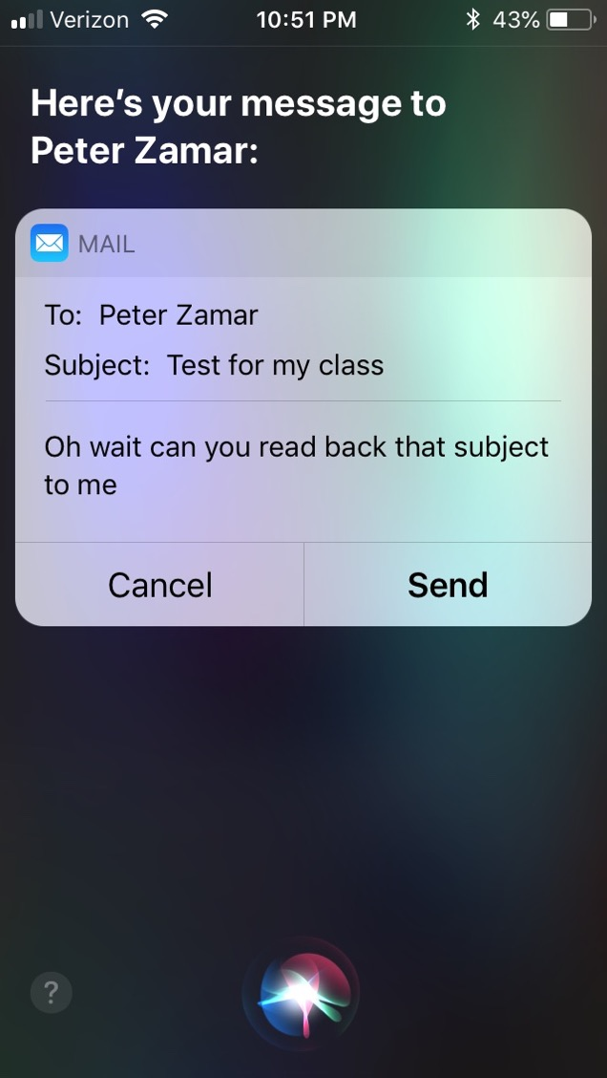

Slide 39
GUS: Still pretty passive
GUS wants to fill slots
What if you stop filling slots and try to ask a question?
What's going wrong?
GUS (siri) doesn't have any real idea of my intents!

Slide 40
Dialog-State Architecture
Like GUS:
Fill in slots
NLU to parse user utterances
Unlike GUS:
Keep track of what the user is doing beyond providing information
Asking a question
Talking to someone else
Understand the discourse context
Requires keeping track of what happened in the past
Two New Components
Dialog State Tracker
Dialog Policy

Slide 42
Dialog Policy
Given the state and the acts, what should happen next
E.g. during email composition:
Sudden question with high intonation? Interpret as command
Otherwise, interpret as text

Slide 43
Dialog Acts
Consider each line in a dialogue to be a kind of action
Just like in an FSA, then, dialog states are the states reached by following dialog act(ion)s.
What are the kinds of dialog acts?
How do we classify dialog lines into acts?

Slide 44
Domain-Focused fine-grained acts

Slide 45
Example

Slide 46
How Is This Done?
Need to identify speech act, then need to find slot-values.
Typically all done at once, in joint state/act-finding procedure:
Speaker | Dialogue | Act/State
User | I'm looking for a cheaper restaurant | INFORM(price=cheap)
System | Sure, What kind and where?
User | Thai food, somewhere downtown | INFORM(price=cheap,food=Thai,area=center)
System | The House serves cheap Thai food
User | Where is it? | Inform(price=cheap,food=Thai,area=center); REQUEST(address)
System | The House is at 106 Regent Street
(Mrkšić et al. 2017)

Slide 47
Syntax Clues
Dialogue | Act | Clues
Will breakfast be served on Delta 1557? | YES-NO QUESTION | Auxiliary ("will") precedes subject ("breakfast")
I don't care about lunch. | STATEMENT | Declarative syntax (no inversion)
Show me flights from LA to SF | COMMAND | No subject
But...
Can you show me the flights from LA to SF? | YES-NO QUESTION | Prosody (if speech)
COMMAND

Slide 48
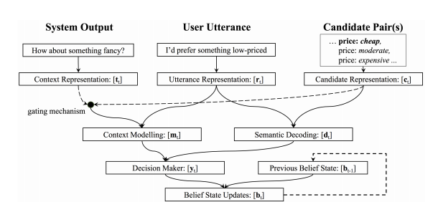
How It's Done (Neural Belief Tracker)
Note: fixed embeddings
(Mrkšić et al. 2017)

Slide 49
More Important Than Model: Data!
DSTC2: Dialogue State Tracking Challenge 2
Transcriptions, ASR hypotheses, and turn-level labels from interactions with a virtual agent
3300+ dialogues about restaurant selection
Fixed Ontology of states
WOZ 2.0
Text archives of wizard-of-oz restaurant selection
No speech, so no asr.
More expressive communication
1200 dialogues

Slide 51
Evaluation (from static corpus)
Domain / intent classification accuracy (sentence level)
Slot identification – Macro F1 (span level)
Exact match of slots (and intent) (sentence level)

Slide 52
Evaluation (from active interaction)
Slot Error Rate for a Sentence
# of inserted/deleted/subsituted slots
# of total reference slots for sentence
End-to-end evaluation (Task Success): # successful dialogues/# dialogues

Slide 53
Evaluation Metrics
“Make an appointment with Chris at 10:30 in Gates 104”
Slot | Filler
PERSON | Chris
TIME | 11:30 a.m.
ROOM | Gates 104
Slot error rate: 1/3
Task success: At end, was the correct meeting added to the calendar?

Slide 54
Results from Neural Belief Tracker

Slide 55
Google Duplex
Deprecated 12/22! (“phone calls from google assistant”)
Very realistic ASR
great speech synthesis
disfluencies in a lot of the right places
Task-oriented bot but flipped roles
you communicate with it via google assistant
duplex calls restaurants and provides info
Very narrow domain/intent space
only restaurants, only specific ones they’ve vetted
falls back to human 25% of the time
Lots of details not revealed

Slide 56
Summary
Task-Oriented Dialogue major paradigm is frame-filling
SOTA in production largely still rule-based
Major accomplishments are multi-turn ability
Newer approaches try to model dialogue acts, build end-to-end understanding
Not much said about response generation here
Next time: more about generation when discussing chit-chat bots

Slide 57
Divide The World
(Goal-based) Dialog agents
SIRI, interfaces to cars, robots,
booking flights or restaurants
(No goal) Chatbots
Now!
The word "chatbots" is sometimes used in the popular press for both. We'll use it only for #2.

Slide 58
Why is building a chatbot hard ?
Computers need to understand what you ask.

Slide 59
Why is building a chatbot hard ?
Computers need to understand what you ask.
Computers need to generate coherent, meaningful sequences in response to what you ask,

Slide 60
Why is building a chatbot hard ?
Computers need to understand what you ask.
Computers need to generate coherent, meaningful sequences in response to what you ask, that require domain knowledge, discourse knowledge, world knowledge

Slide 61
Why is building a chatbot hard ?
Computers need to understand what you ask.
Computers need to generate coherent, meaningful sequences in response to what you ask, that require domain knowledge, discourse knowledge, world knowledge
Responses from the same bot need to be consistent.

Slide 62
Why is building a chatbot hard ?
Computers need to understand what you ask.
Computers need to generate coherent, meaningful sequences in response to what you ask, that require domain knowledge, discourse knowledge, world knowledge
Responses from the same bot need to be consistent.
A bot should be interactive.

Slide 63
Why is building a chatbot hard ?
Computers need to understand what you ask.
Computers need to generate coherent, meaningful sequences in response to what you ask, that require domain knowledge, discourse knowledge, world knowledge
Responses from the same bot need to be consistent.
A bot should be interactive.
5. Evaluation is very unclear!

Slide 64
Human Evaluation: The Turing Test (Turing, 1950)
"The Imitation Game" (see film of the same name)
As originally posed, an interrogator asks questions of a machine and a human and both try to convince the interrogator that they are human.
Turing predicted 30% of interrogators would be fooled within 5 minutes by 2000 (not a super high bar)
Weird side note: apparently the original form of this game was played with a man and a woman, both trying to convince the interrogator that they are the woman.
Not really clear this is a test of intelligence. Maybe a longer conversation?

Slide 65
Human Evaluation In Practice
Show multiple system responses to the same prompt
Ask humans which they prefer

Slide 66
Chatbots!
ELIZA (1966)
PARRY (1968)
The first system to pass the Turing test!!!!
ALICE (90s-00s)
won Loebner prize but not Turing Test
Cleverbot (08-teens)
IR-based, good online support, some notoriety for google home devices talking to each other
first gen transformer models – DialoGPT (20), BlenderBot (20)
ChatGPT, LlamaChat, Falcon-Chat, h2oGPT, ... – use RLHF

Slide 67
Chatbot Architectures
Rule-based
Pattern-action rules (Eliza)
+ a mental model (Parry)
Corpus-based (from large chat corpus)
Information Retrieval
Neural network encoder-decoder

Slide 68
Chatbots
Sometimes for fun
But originally designed as a testbed for clinical therapy
(And still used that way!)

Slide 69
Eliza: Weizenbaum (1966)
Men are all alike. IN WHAT WAY They're always bugging us about something or other.
CAN YOU THINK OF A SPECIFIC EXAMPLE
Well, my boyfriend made me come here. YOUR BOYFRIEND MADE YOU COME HERE
He says I'm depressed much of the time. I AM SORRY TO HEAR YOU ARE DEPRESSED
...
WHO ELSE IN YOUR FAMILY TAKES CARE 0F YOU? My father YOUR FATHER

Slide 70
You are like my father in some ways.
WHAT RESEMBLANCE DO YOU SEE
You are not very aggressive but I think you don’t want me to notice that.
WHAT MAKES YOU THINK I AM NOT AGGRESSIVE
You don’t argue with me.
WHY DO YOU THINK I DON’T ARGUE WITH YOU
You are afraid of me.
DOES IT PLEASE YOU TO BELIEVE I’M AFRAID OF YOU
My father is afraid of everybody.
WHAT ELSE COMES TO MIND WHEN YOU THINK OF YOUR FATHER
Bullies.
DOES THAT HAVE ANYTHING TO DO WITH THE FACT THAT YOUR BOYFRIEND MADE YOU COME HERE

Slide 71
How does it work? Eliza uses this one weird trick

Slide 72
That trick: be a Rogerian psychologist
Draw the patient out by reflecting patient’s statements back at them
Rare type of conversation in which one can “assume the pose of knowing almost nothing of the real world”

Slide 73
Rogerian psychologist
Patient: "I went for a long boat ride”
Psychiatrist: "Tell me about boats”
You don’t assume she didn’t know what a boat is
You assume she had some conversational goal
Chatbots trying to pass the Turing test usually choose some such domain

Slide 74
Eliza pattern/transform rules
((*) YOU (*) ME) [pattern]
(WHAT MAKES YOU THINK I \3 YOU) [transform]
You hate me
WHAT MAKES YOU THINK I HATE YOU

Slide 76
Keywords are ranked from specific to general
I know everybody laughed at me
“I” is a very general keyword:
I: (I (*)) -> (You say you \2)
YOU SAY YOU KNOW EVERYBODY LAUGHED AT YOU
“Everybody” is much more interesting (someone using universals like everybody/always is probably “referring to some quite specific event or person”)
WHO IN PARTICULAR ARE YOU THINKING OF?
Implementation: keywords stored with their rank
Everybody 5 (transformation rules)
I 0 (transformation rules)

Slide 77
NONE
PLEASE GO ON
THAT’S VERY INTERESTING
I SEE

Slide 78
Memory
(MEMORY MY (0 YOUR 0 = LETS DISCUSS FURTHER WHY YOUR 3)
(0 YOUR 0 = EARLIER YOU SAID YOUR 3)
Whenever “MY” is highest keyword
Randomly select a transform on the MEMORY list
Apply to sentence
Store on a stack
Later, if no keyword matches a sentence
Return the top of the MEMORY queue instead
A hierarchical model of discourse

Slide 79
Some implications
People became deeply emotionally involved with the program
Weizenbaum tells the story of his secretary who would ask Weizenbaum to leave the room when she talked with ELIZA
When he suggested that he might want to store all the ELIZA conversations for later analysis, people immediately pointed out the privacy implications
Suggesting that they were having quite private conversations with ELIZA

Slide 80
ELIZA Unearthed
Nobody actually ever saw the code
There are a lot of imitations out there but without exactly the same behavior reported in the paper
In 2021 a small team unearthed the paper records of the code and has been transcribing the actual original code and other related imitations at https://sites.google.com/view/elizagen-org/the-original-eliza
Mostly of historical interest but there are some actual apps you can use to try it out (iAltair on iphone...)

Slide 81
Parry
Colby 1971 at Stanford; used to study schizophrenia
Same pattern-response structure as Eliza
But a much richer:
control structure
language understanding capabilities
mental model: Parry has affective variables
Anger, Fear, Mistrust
“If Anger level is high, respond with hostility”
The first system to pass the Turing test (in 1971)
Psychiatrists couldn’t distinguish interviews with PARRY from (text transcripts of) interviews with real paranoids
Might say something about psychiatrists, though...

Slide 82
Parry’s persona
28-year-old single man, post office clerk
no siblings and lives alone
sensitive about his physical appearance, his family, his religion, his education and the topic of sex.
hobbies are movies and gambling on horseracing,
recently attacked a bookie, claiming the bookie did not pay off in a bet.
afterwards worried about possible underworld retaliation
eager to tell his story to non-threating listeners.

Slide 83
Affect variables
Fear and Anger (each ranging 0-20)
Mistrust (ranging 0-15)
Initial conditions: All low
After each user turn, if nothing malevolent in input
Anger drops by 1, Fear drops by 0.3
Mistrust drops by 0.05 to base level
Otherwise depends on what the user says
Each user statement can change Fear and Anger
Insults increases Anger by some percentage
Mistrust goes up if Fear or Anger do

Slide 84
Lots of complex I-O rules
User implies Parry is mentally ill
Rise in Fear and Anger
User mentions “Mafia” or associated concepts (“kill”):
First mention: rise in Fear
Later mentions: depends on willingness to discuss, which depends on current levels of Fear, Anger, Mistrust
User mentions Parry
Flattery (positive mention)
Decreases fear/anger if Mistrust is low
Increases Anger if Mustrust is high
User attitudes toward Parry
Negative attitudes (fear, disbelief) increase Fear/Anger

Slide 85
Flare concepts
List of concepts related to Mafia
An ordered graph designed to lead interviewer to topic
horses→ horseracing→gambling→bookies→underworld→Mafia
The mention of a new flare topic by interviewer causes a rise in Fear
Flare topics cause Parry to give preset responses to that flare

Slide 86
A Parry conversation
(1) How are you today?
OK. (2)What is your name?
MY NAME IS FRANK SMITH.
(3) How old are you?
TWENTY-EIGHT. (4) Are you married? NO. (5) What sort of work do you do?
I WORK IN THE POST OFFICE.
(6) Why are you in the hospital?
I SHOULDN’T BE HERE
(7) Who brought you here?
THE POLICE
[FEAR rises slightly because police linked in graph to MAFIA]

Slide 87
When fear is high, the model won’t discuss its beliefs
(1) Is the law after you?
THE LAW SHOULD GET THOSE ITALIAN CROOKS.
(2) Do you mean the Mafia?
LET'S TALK ABOUT SOMETHING ELSE.
(3) Are you afraid of the Mafia
I'D RATHER NOT DISCUSS IT.
[Fear is too high so Parry won’t talk about 'Mafia’.] (4) Perhaps you are paranoid about them?
YOU WANT TO KEEP ME IN THE HOSPITAL. (The model interprets being called 'paranoid’ as an insult and as an intent to control, so ANGER & FEAR rise)

Slide 88
IR-based chatbots
Idea: Mine conversations of human chats or human-machine chats
Microblogs: Twitter or Weibo (微博)
Movie dialogs
Cleverbot (Carpenter 2017 http://www.cleverbot.com)
Microsoft XiaoIce
Microsoft Tay

Slide 89
A Cleverbot conversation
User: | Do you like Doctor Who?
Cleverbot: | Yes, so funny
User: | What's your favorite show?
Cleverbot: | I don't have one
User: | What's your name?
Cleverbot: | Jason I already told you.
User: | No your real name.
Cleverbot: | Stephanie IS my real name.
User: | I thought it was Jason?
Cleverbot: | How did you come to that conclusion.
User: | Because you said so.
Cleverbot: | I have to do my homework.

Slide 90
Terminology
Think of dialogue as a sequence of turns and responses.
Every item is a turn, and every item is a response to the turn before it.
good morning 😊
morning hun. How are you this morning?
I'm good thank you. How are you?
doing good, very cold tho lol
raining like crazy here.
Hate rain 👎🏻 that mixed with cold. The other day it was pouring
yeah, I'm with you. Lol
Hope you have a great day and a warm one :)
I will, thank you. Be safe and have a wonderful day 😊
You too hun
turn
response to turn 3
response to turn 4
Twitter data from https://github.com/Phylliida/Dialogue-Datasets – so much of it was NSFW!

Slide 91
Two IR-based chatbot architectures
Similar Turn: Return the response to the most similar turn
Take user's turn (q) and find a similar turn t (cosine over tf-idf or sentence embedding) in the corpus C
q = "do you like Doctor Who"
t = "do you like Doctor Strangelove"
Grab whatever the response was to t.
Similar Response: Return the most similar turn
Yes, so funny
Do you like Doctor Strangelove

Slide 92
Comparing approaches
Similar turn seems more likely to work, intuitively
However, noise creeps in: similar turn isn't the same, and response is response to something else.
Results from "Data-Driven Response Generation in Social Media" (Ritter et al. 2011):
Turn (prompt) | Similar Turn | Similar Response
riding to the arc on my bike. Hopefully I won’t melt into the pavement. | grab some refreshing drinks ... and a towel ... lol ... then eat ice cream and suika later ... | u sure the cup wo n’t melt ?
I really hate watching movies in the living room. | :( cheer up ! you need to invest in one of those turbo fans | someone was watching in the living room kasi e . :) i was too lazy to go up to my room .
Hello Did I miss David Getting his teen choice award? Or did they not show it | it did n’t show yet -ha- -lol | are they gon na show teen choice awards again ? i missed it

Slide 93
Another Approach: MT-based
Build a "parallel corpus" and treat the entire task like machine translation
This was done pre-neural MT, so alignment had to be dealt with; another method for determining phrase pairs was used (Fisher's exact test; don't worry about details)
Works pretty well, empirically
Source | Target
good morning 😊 | morning hun. How are you this morning?
morning hun. How are you this morning? | I'm good thank you. How are you?
I'm good thank you. How are you? | doing good, very cold tho lol
doing good, very cold tho lol | raining like crazy here.
raining like crazy here. | Hate rain 👎🏻 that mixed with cold. The other day it was pouring
Hate rain 👎🏻 that mixed with cold. The other day it was pouring | yeah, I'm with you. Lol
yeah, I'm with you. Lol | Hope you have a great day and a warm one :)

Slide 94
Empirical Evaluations
Note: BLEU not informative, though it ends up getting used a lot as it's better than nothing (but not much)
System A | System B | % A preferred
MT | Similar Turn | 64.5
MT | Similar Response | 59.3
Similar Turn | Similar Response | 42.2
MT | Human | 14.5
MT | Random | 88.0
System | BLEU %
Similar Turn | 0.5
Similar Response | 1.5
MT | 1.1
Random | 0.1

Slide 95
Turn (prompt) | Similar Turn | Similar Response | MT | Human | Random
riding to the arc on my bike. Hopefully I won’t melt into the pavement. | grab some refreshing drinks ... and a towel ... lol ... then eat ice cream and suika later ... | u sure the cup wo n’t melt ? | good luck on your bike ride arc | make sure to ride in the middle of the street | lmfaoooo !
I really hate watching movies in the living room. | :( cheer up ! you need to invest in one of those turbo fans | someone was watching in the living room kasi e . :) i was too lazy to go up to my room . | me too , what movies are you doing in room ? | Why? no comfy spots or just too open to public | tas fazendo oq ?
Hello Did I miss David Getting his teen choice award? Or did they not show it | it did n’t show yet -ha- -lol | are they gon na show teen choice awards again ? i missed it | hello miss ? * he was getting his will probably win | nothing yet...he presented though he is so darn cute | you wish .

Slide 96
Evaluation of ChatBots is Hard!
Purely automatic metrics don't seem sufficient
Human metrics have all the same problems humans usually have (inconsistent, expensive); can measure length of engagement, can ask opinion...
There is lots of active research into this (not presented here)!

Slide 97
Seq2Seq Models for Response Generation
I’m
fine
.
EOS
Encoding
Decoding
how
are
you
?
eos
I’m
fine
.
Mostly same old story: LSTMs, then Transformers, but need lots of data

Slide 98
Chat Data
Chat example dialogue corpora – lots! including...
ConvAI – crowd sourced conversations between humans and humans or bots (v2: 131k turns, 18k dialogues)
PersonaChat – 200k human dialogues given artificial “personas”
Cornell Movie Dialogues – scripted dialogue from movies (300k turns, 617 movies)
Daily Dialog – crawled english learning dialogues (labeled with emotion and topic). 104k turns, 13k dialogues
OpenAssistant – human generated assistant-style conversations; 161k turns, 35 languages, 10k conversations, scored for quality
Wizard of Wikipedia – 167k turns, 18k dialogues, discussions grounded in wikipedia articles
Non-dialogue retrofitted sets
Twitter/Reddit “dialogue” – posts and responses
commonsense qa – 12k questions, multiple choice
natural questions – 300k questions and answers sourced online

Slide 99
General Approach (e.g. h2oai, but there are slight variations)
Pretrain Model
several weeks of next-word prediction on The Pile, RefinedWeb, etc. (TiB-level internet data with varying amounts of secret cleaning)
Finetune Model
predict output given input using e.g. openassistant or similar conversation corpus
more efficient fine tuning using parameter-efficient methods such as LoRA
RLHF tuning (possibly not in h2oai?)
For task instead of token quality
Using task quality model, evaluate generated dialogues and use techniques like PPO to adjust weights to improve according to quality metric

Slide 100
Specific Dialogue Approaches
There are lots and it’s an emerging game! Here are some recent ones
Persona-based – try to understand the “style” of a participant as distinct from content
Graph, memory, and other more complicated networks to recognize long term trends in conversations more clearly
Techniques to avoid repetition and safe responses
rules
sampling
mutual information

Slide 101
Still Not So Great (in 2023)
Multi-Turn Dialogues – when to weigh in?
Spoken Dialogue – different from text, and requires speech-text-text-speech stack (we can do it, it’s just not that natural yet)
Very long conversations? You tell me...is an hour of chatgpt similar to an hour with bff?
Lower resourced languages – see also MT
other hot topics?

Slide 102
Sample Results from Google’s baseline paper
Input | Response
what is moral ? | what empowered humanity
what is immoral ? | the fact that you have a child .
what is the purpose of existence ? | to find out what happens when we get to the planet earth .
what do you think about bill gates ? | He’s a good man

Slide 103
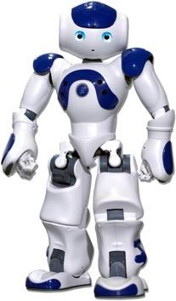

Problem: Generic Responses
“I don’t know“ problem (Sordoni et al., 2015; Serban et al.,2015; )
How old are you ?
I don’t know .
"A Diversity-Promoting Objective Function for Neural Conversation Models" – Li et al. 2016

Slide 104
Generic Responses
“I don’t know“ problem (Sordoni et al., 2015; Serban et al.,2015; )
How is life ?
I don’t know what you are talking about.
Notes:
30% percent. This behavior is ascribed

Slide 105
How to deal with Generic Responses
“I don’t know“ problem (Sordoni et al., 2015; Serban et al.,2015; )
Do you love me ?
I don’t know what you are talking about.
30% percent of all generated responses
Notes:
30% percent. This behavior is ascribed

Slide 106
How to deal with Generic Responses
Solution #1: Adding Rules

Slide 107
How to deal with Generic Responses
Solution #1: Adding Rules
I don’t know .
I don’t know ..
I don’t know …
...
I don’t know !
I don’t know ! !
I don’t know ! ! !
Notes:
Regular expression matching

Slide 108
How to deal with Generic Responses
Solution #1: Adding Rules
I don’t have the foggiest idea what you are talking about .
I have no idea .
I don’t know .
I don’t know ..
I don’t know …
...
I don’t know !
I don’t know ! !
I don’t know ! ! !
I don’t have a clue.
I don’t have the lightest idea what you are talking about .
I haven’t the faintest idea
How should I know ?
Notes:
Unfortunately, deep learning model manage to cluster all phrases that are semantically related to I don’t know.
Most comprehensive “I don’t know” list I have ever seen …

Slide 109
How to deal with Generic Responses
Solution #1: Adding Rules
I don’t have the foggiest idea what you are talking about .
I have no idea .
I don’t know .
I don’t know ..
I don’t know …
...
I don’t know !
I don’t know ! !
I don’t know ! ! !
I don’t have a clue.
I don’t have the lightest idea what you are talking about .
I haven’t the faintest idea
How should I know ?
Rules don’t work !!
Notes:
Unfortunately, deep learning model manage to cluster all phrases that are semantically related to I don’t know.
Most comprehensive “I don’t know” list I have ever seen …

Slide 110
How to deal with Generic Responses
Solution #1: Adding Rules
I don’t have the foggiest idea what you are talking about .
All top responses are generic
I have no idea .
I don’t know .
I don’t know ..
I don’t know …
...
I don’t know !
I don’t know ! !
I don’t know ! ! !
I don’t have a clue.
I don’t have the lightest idea what you are talking about .
I haven’t the faintest idea
How should I know ?
Rules don’t work !!
Notes:
Unfortunately, deep learning model manage to cluster all phrases that are semantically related to I don’t know.
Most comprehensive “I don’t know” list I have ever seen …

Slide 111
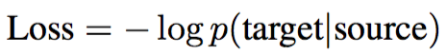
Consider Standard Cross-Entropy for Response Generation.

Slide 112
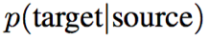
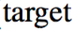
Consider Standard Cross-Entropy for Response Generation.

Slide 113
Consider Standard Cross-Entropy for Response Generation.
“I don’t know”
Whatever one asks
It's always going to be fairly high because it is safe

Slide 114

What one asks
“I don’t know”

Slide 115
“I don’t know”
Nothing unique will ever be more likely than something safe
What one asks
“I don’t know”
What one asks
The safe answer has lots of possible setups, none particularly likely
Notes:
The other way around

Slide 116
“I don’t know”
Nothing unique will ever be more likely than something safe
What one asks
“To the beach”
“I don’t know”
What one asks
The safe answer has lots of possible setups, none particularly likely
The interesting answer may have support for only one setup. So search for that interesting answer.
Notes:
The other way around

Slide 117
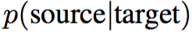
Intuitively, we should incorporate the other conditional probability too!

Slide 118
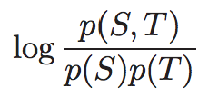
Mutual Information for Response Generation.
Another way to look at it: Mutual Information!
Search for the element that is most "intersting" in this case.

Slide 119
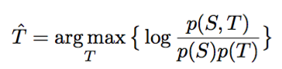
Mutual Information for Response Generation.
=P(T|S)/P(T) (def. of conditional probability)

Slide 120
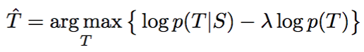
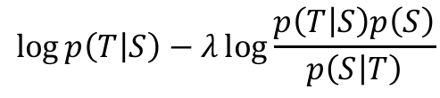
Mutual Information for Response Generation.
Just a heuristic
$$\log{p\left(T | S\right)−λ\log{\frac{p\left(T | S\right)p\left(S\right)}{p\left(S | T\right)}}}$$
$$\log{p\left(T | S\right)−λ(log{p\left(T | S\right)+\log{p(S)}−\log{p\left(S | T\right)})}}$$
$$(1−λ)log{p\left(T | S\right)+λ\log{p\left(S | T\right)[−λ}\log{p\left(S\right)]}}$$

Slide 121
Mutual Information for Response Generation.
Bayes' Rule

Slide 122
Mutual Information for Response Generation.
Bayes' Rule
Implementation: Generate n-best lists and rerank!

Slide 123
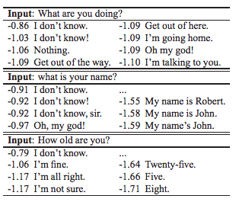
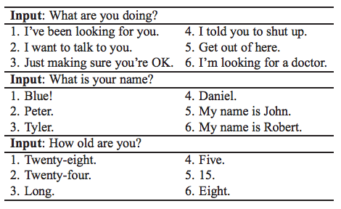
Sampled Results
Standard Seq2Seq p(t|s)
Mutual Information
Notes:
Too small

Slide 124
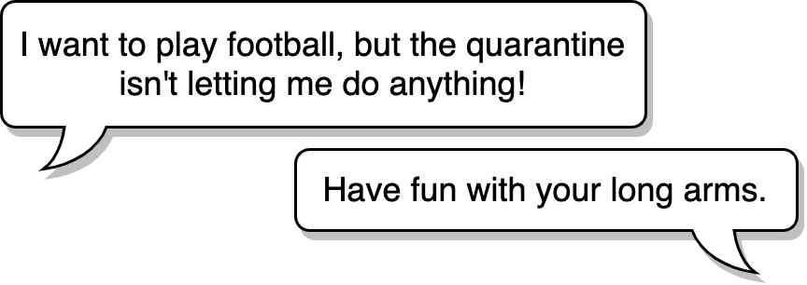


Issues with Conversational Dialogue Systems
Irrelevant, non-sensical response:
DialoGPT (Zhang et al. 2019)
Notes:
As part of the trade-off to become general enough to answer anything, the models sometimes respond with something that is completely irreleveant and non-sensical. Look at this response from a DialoGPT model released late last year by Microsoft.
THe rep
Should I / Do I have time to list related work that have previously tried to address these issues and how they overlooked this aspect of communication.
First example from mitsuku: winner of the Loebner Prize a record 5 times.
https://www.pandorabots.com/mitsuku/
Second example from DialoGPT implementation on colab, link from official DialoGPT repo: https://colab.research.google.com/drive/1PslHE4Rl4RqSa20s7HEp0ZKITBir6ezE
Cleverbot example from cleverbot

Slide 125
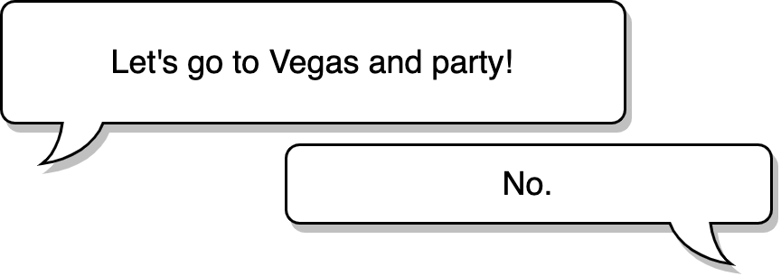

Issues with Conversational Dialogue Systems
Relevant but non-specific response:
Cleverbot (https://www.cleverbot.com/)
These responses are undesirable due to a lack of grounding
Notes:
Another commonly known problem is responding with a relevant but generic response that could work for many cases, such as I don’t know or simply No or Yes in this example. This preempts further conversation or forces the user to be creative in order to continue a conversation.
We believe that these responses we’ve shown you are undesirable because of a lack of grounding.

Slide 126
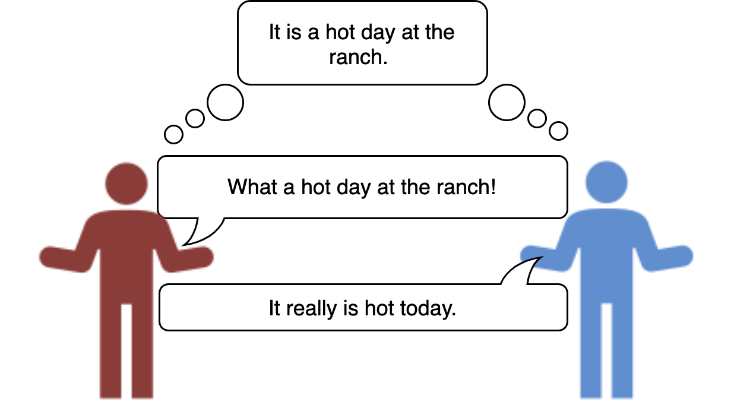
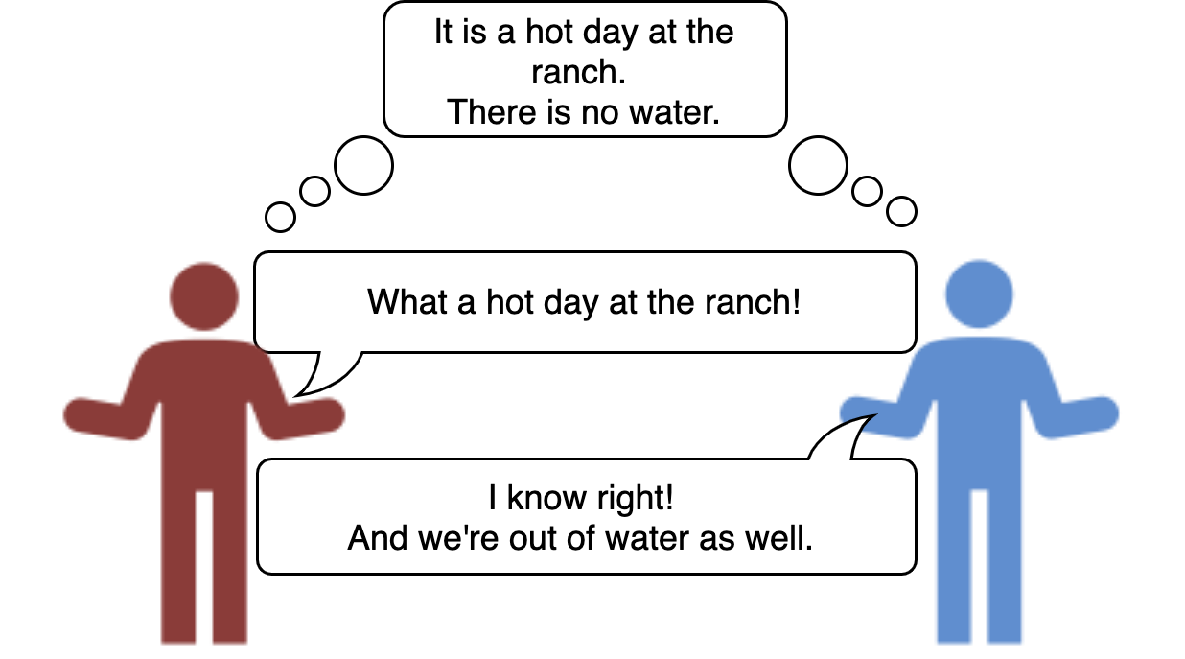
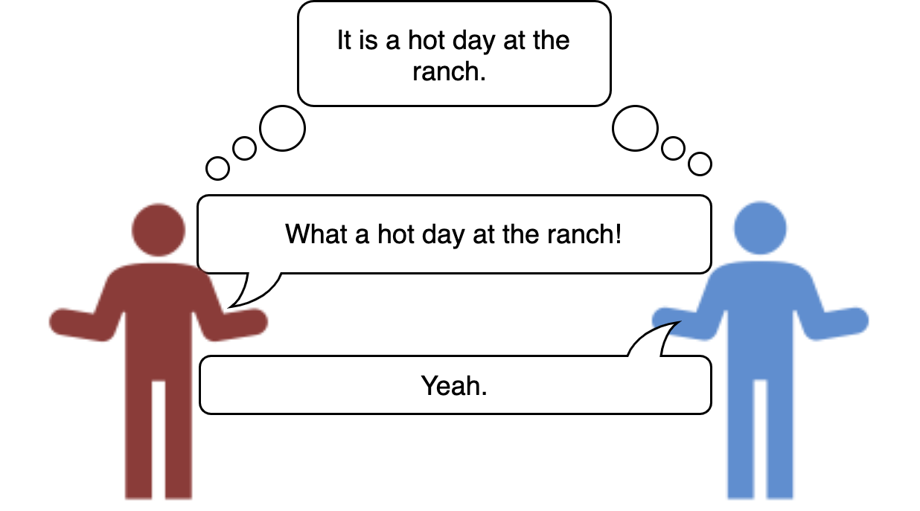

What is Grounding?
Establishing common ground or a shared world state through cooperation
Dimensions of grounding (Clark and Shaefer, 1989)
Display → verbatim repetition
Demonstrate → articulate part of input
Acknowledgement → Nodding or expressing agreement.
Initiation of relevant new contribution→ Start in on the next contribution that would be relevant at a level as high as the current one (most effective)
Notes:
Groudning is any means that is used to establish a common ground or a shared world state through cooperation
Clark and Shaefer outlines a list of dimensions fo grounding that have varying degrees of showing engagement.
Display → verbatim repetition
Demonstrate → articulate part of input
Acknowledgement → Nodding or expressing agreement.
Initiation of relevant new contribution→ Start in on the next contribution that would be relevant at a level as high as the current one (most effective)

Slide 127
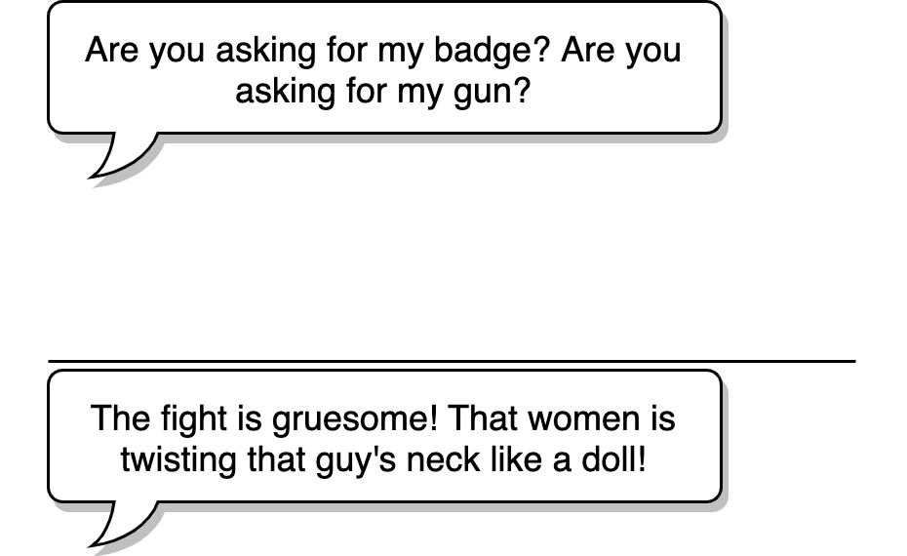
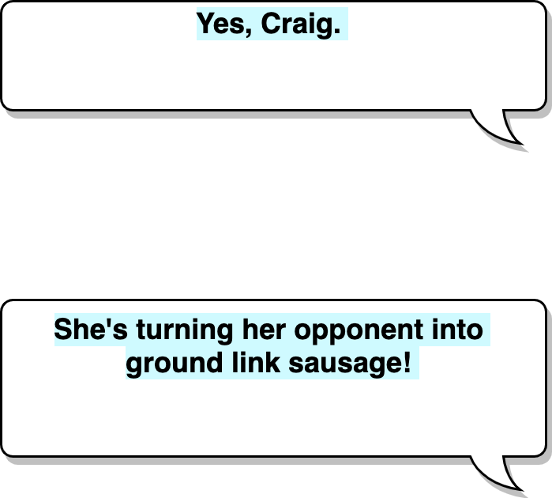
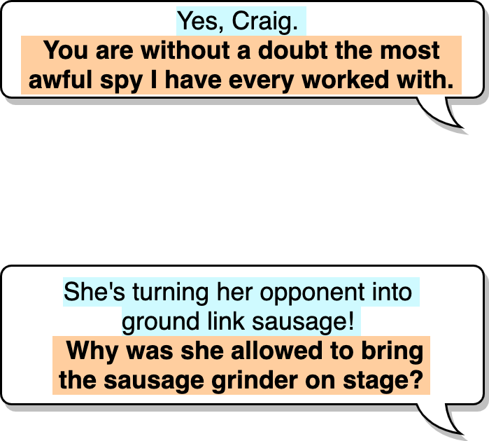
Inspiration from Improvisational Theatre (Improv)
Grounding is prevalent in improv as it abides by the “Yes, and” principle
A prompt must establish some information about the current scene that the actors are a part of
A response to a prompt should
accept the given reality from previous dialog turns (“Yes”)
and add new information or further refine the given reality (“and”)
We call these prompt-response pairs yes-ands
How can we use improv to build dialogue systems better at grounding?
Notes:
For our work we're drawing inspriation from improvisational theatre, improv because improvisers rely on various grounding techniques to act out a scene. One o the most important principles in imprvo is yes-and principle. It states that ...

Slide 128
Goals
Understand the “Yes, and” principle through collection of yes-ands
Use yes-ands as training data to build dialogue systems that produce coherent responses given some topic inputs (prompts)
Deliver a system through a web interface so a human can play the part of one actor (and log the generated output)
Notes:
We want to leverage this relativley well-defined principle and collect them to better understand yes-ands.
We will want to use this collected text-based training data to leverage existing state of the art language models to build dialogue systems

Slide 129

Limitations of Existing Dialogue Datasets
Most text-based dialogue corpora are scripted and have small proportions of yes-ands (Only 11.1% for Cornell)
DailyDialog
(Li et al. 2017)
104K utterances
Persona-chat
(Zhang et al. 2018)
162K utterances
Cornell Movie-Dialogs Corpus
(Danescu-Niculescu-Mizil and Lee, 2011)
304K utterances
OpenSubtitles
(Lison and Tiedemann, 2016)
441M sentences
Notes:
So what do we have at hand to take advantage of?
Well there are existing text-based dialogue datasets.

Slide 130
What about existing improv corpora?
None!
Most spontaneous dialog data are audio recordings
What about making one?

Slide 131
Spontaneanation by Paul F. Tompkins
Improv podcast hosted by Tompkins
200 episodes of ~30minutes of long-form improv
43K lines of spoken dialogue with about 50 yes-ands per episode. (=about 25% of all dialogue turns)
No transcripts available
Notes:
This is exactly what we do.
We find

Slide 132
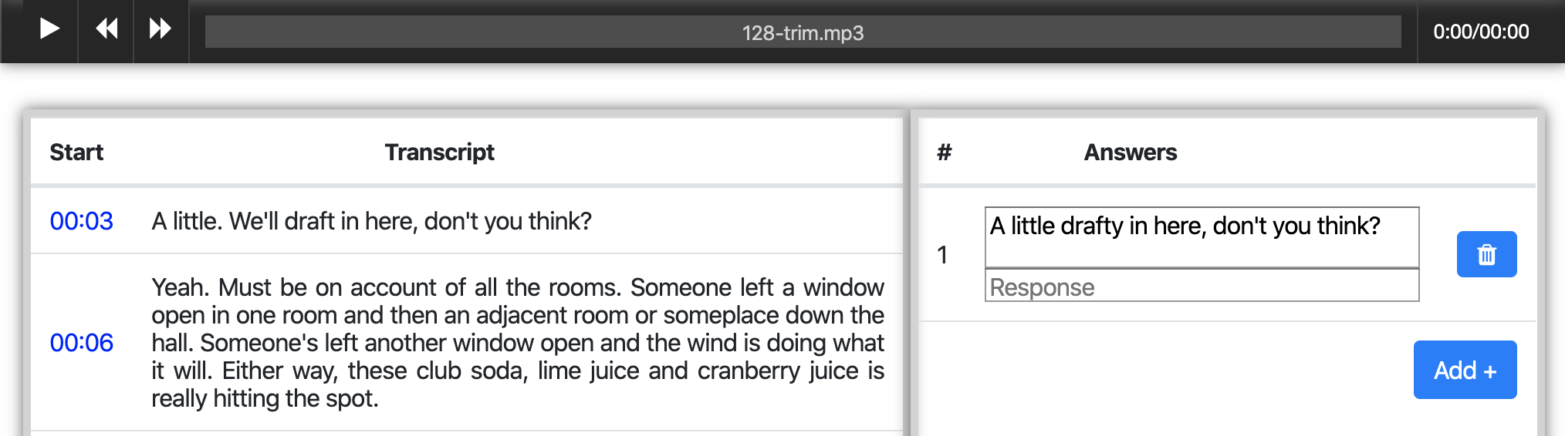
Mechanical Turk Interface
→ 10,459 yes-ands from Spontaneanation. Not enough!
Notes:
On the same slide say how mnay have been collected, emphasize it’s not huge compared to other corpora

Slide 133


Cornell Movie-Dialogs Corpus
Most similar in domain to Spontaneantion among existing text-based dialog corpora
Larger than Spontaneanation but lower concentration of yes-ands
DailyDialog
(Li et al. 2017)
104K utterances
Persona-chat
(Zhang et al. 2018)
162K utterances
Cornell Movie-Dialogs Corpus
(Danescu-Niculescu-Mizil and Lee, 2011)
304K utterances
OpenSubtitles
(Lison and Tiedemann, 2016)
441M sentences
Notes:
This is not enough.

Slide 134
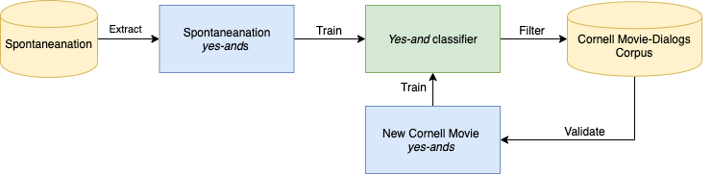
Data Augmentation
Notes:
Let’s try this idea of bootstrapping

Slide 135
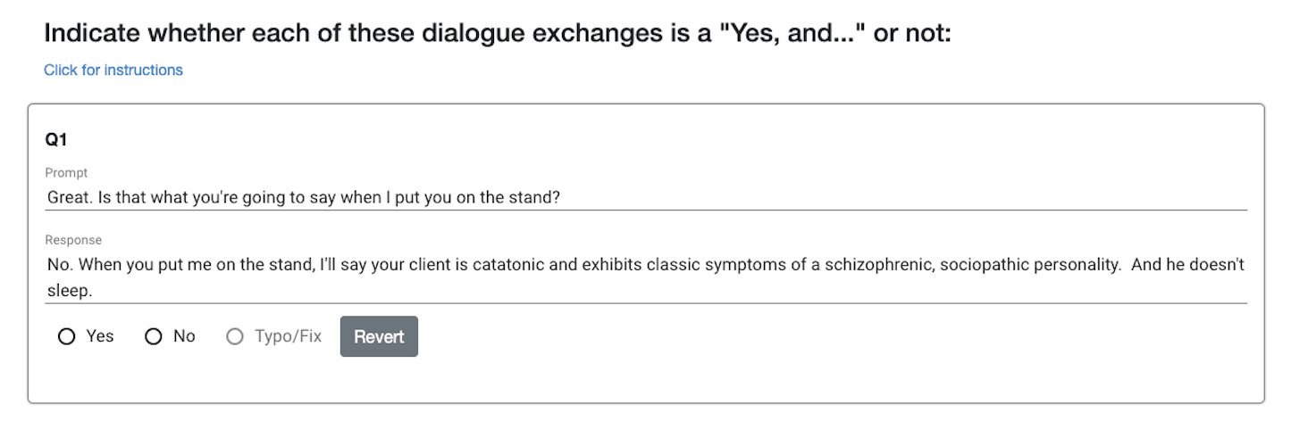
Validation Interface

Slide 136
Iteration Results
Precision
26.9%
44.0%
72.9%
78.4%
Notes:
With each iteration, the trained classifier improves on the average accuracy for the development set (except for the second iteration) and the proportion of new yes-ands increase even with lower confidence thresholds.
Keep this for back up
Instead: more visual representation with concise delivery of the information

Slide 137
Selected Pairs Of Learnable ImprovisatioN (SPOLIN)
Explicit (15%)
P: Does this map look homemade to you?
R: Yeah, it looks like someone without a grasp of English drew it.
Contradiction (5%)
P: Hey, hey, aren’t you afraid you’ll burn out a tonsil?
R: Tonsil? Me? No! Me burn a tonsil?
Implicit (78%)
P: Alright, pull up that plate so I can take a picture.
R: Sorry, the coleslaw is definitely giving off a lot of glare.
Other (95%)
P: I feel different right now.
R: You wait and see. You’re going to marry a big hero!
Yes-but (7%)
P: We all must say the chant that we say to the king.
R: No, it’s too erotic, please don’t.
Notes:
We call our corpus the Selected Pairs of ImprovisatioN corpus, after Viola Spolin.
(Not sure if showing specific types is very useful)
Labelling a subset of the development set shows that most yes-ands are implicit and that only a few non-yesands are contradictions. It shows that in most cases, at least in movies and improv, the reality projected by a previous dialogue turn is rarely outrightly rejected. Usually, it is more irrelevant.
Just a piechart – and just call out the types
Make some examples shorter to make it cleaer

Slide 138

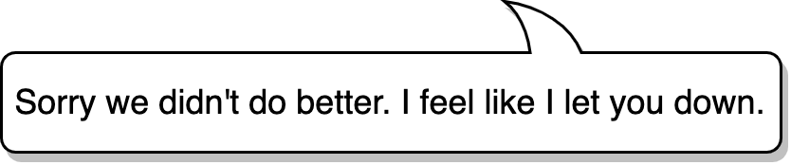



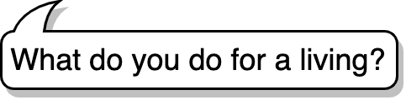
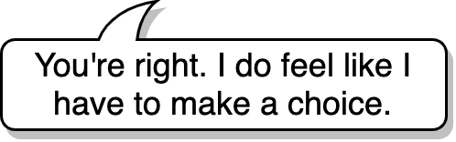
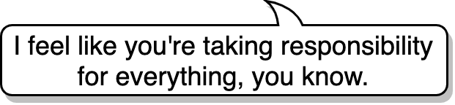
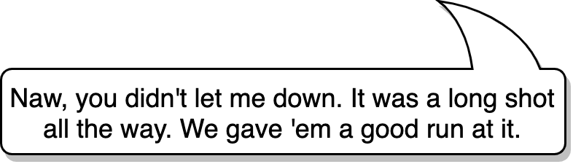
Evaluation
Prompt
Rank responses from GPT-2 models and SPOLIN
Other
SPOLIN
Other → SPOLIN
Gold
SPOLIN
Other: Persona-chat, DailyDialog, Cornell Movie-Dialogs Corpus
Notes:
Explain what others are:

Slide 139
Evalution Results
Source | Average Rank | Example Prompt | Example Responses
Other | 3.59 | I made this beautiful salmon mousse that just looked like a puddle of spit. | What?
SPOLIN | 3.37 |  | And it’s delicious!
Other → SPOLIN* | 3.27 |  | That’s the kind of thing you do when you’re in love.
Gold | 1.93 |  | It was genius. It’s making me hungry thinking about it.
Notes:
Evaluation results show improvements compared to existing datasets, although fine-tuning models with both existing dataset and SPOLIN does not lead to significant improvement except for Persona-chat.
Keep the average of all the models since the pattern is consistent and show fewere examples

Slide 140
Evalution Results
Other
SPOLIN
Other → SPOLIN
Gold
Notes:
Evaluation results show improvements compared to existing datasets, although fine-tuning models with both existing dataset and SPOLIN does not lead to significant improvement except for Persona-chat.
Keep the average of all the models since the pattern is consistent and show fewere examples

Slide 141
SPOLIN-extended
Extract more yes-ands from SubTle (Eng) (Ameixa et al., 2013), a preprocessed subset of the OpenSubtitles
Collected an additional 40,000 yes-ands
DailyDialog
(Li et al. 2017)
104K utterances
Persona-chat
(Zhang et al. 2018)
162K utterances
Cornell Movie-Dialogs Corpus
(Danescu-Niculescu-Mizil and Lee, 2011)
304K utterances
OpenSubtitles
(Lison and Tiedemann, 2016)
441M sentences
Notes:
68K yes-ands & 44K non-yes-ands
Reason for only going through a subset of SubTle:
Heuristics for finding alternations mean that SubTle's utterances are shorter than those in Spontaneantion and Cornell, so once the proportion of utterances longer than the average length of in Spontaneanation and Cornell (18.5 words) is less than 40%, we stop further collection in the remainder of the dataset.
This was collected after the paper submission and with the evaluation results, so the extended version of the dataset has not been systematically evaluated.
Get back to the cylinder diagram and circle subtle and explain it

Slide 142
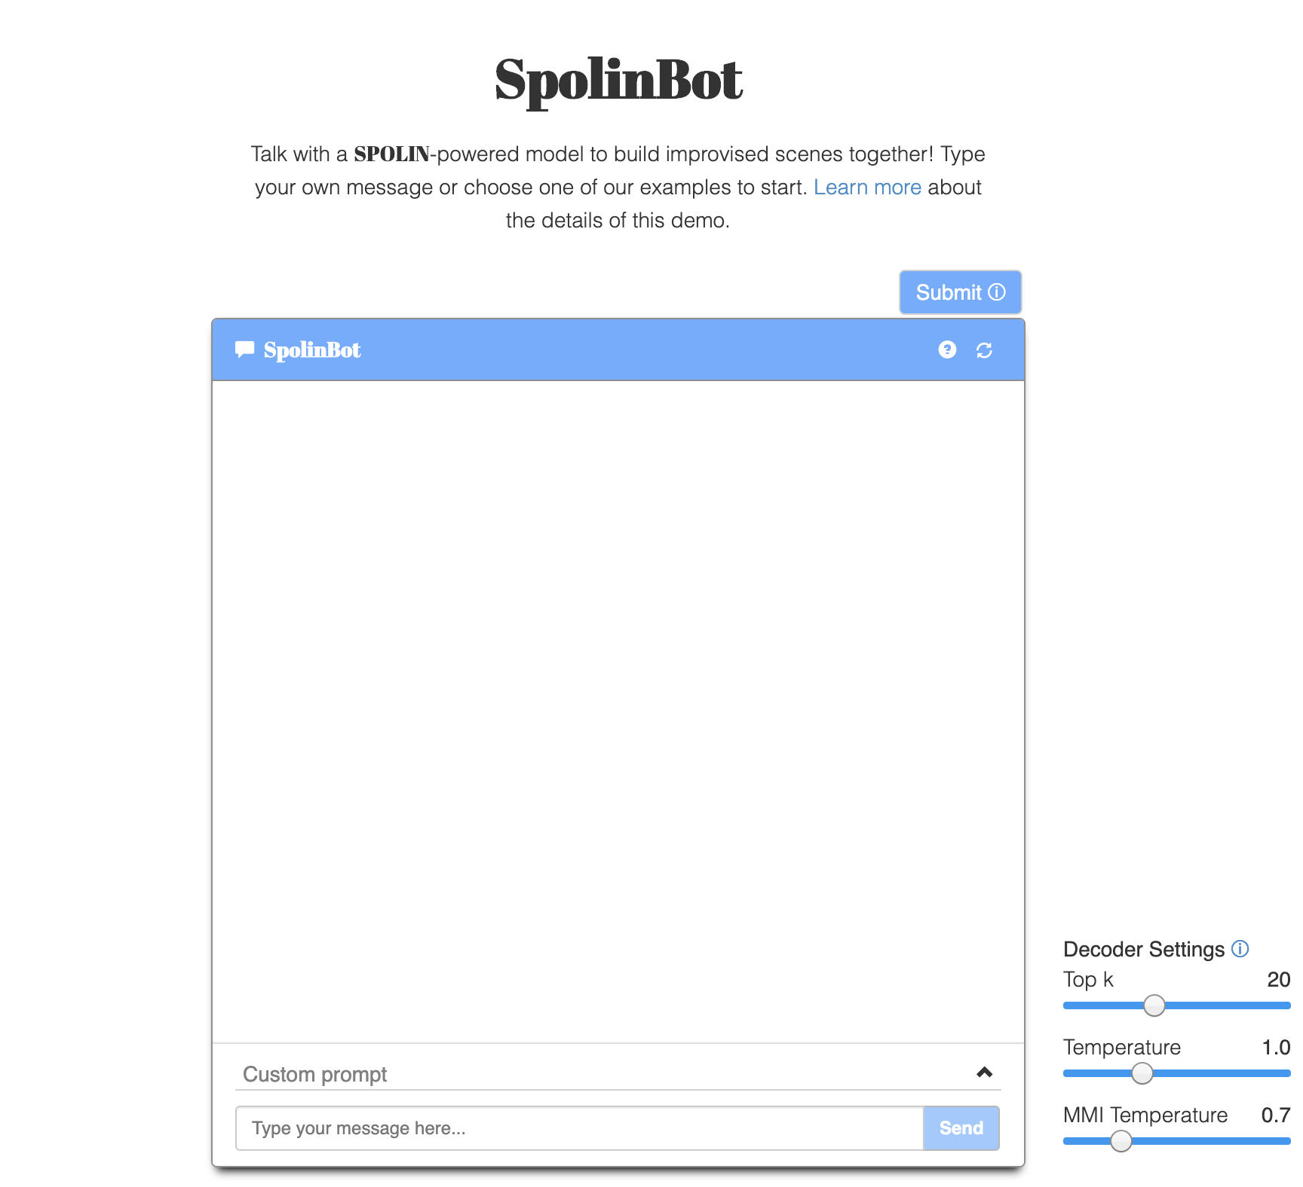
Demo
Built interactive demo with a DialoGPT model fine-tuned with SPOLIN-extended
Uses a reverse model for maximum mutual information (MMI)
Notes:
Show demo if there is time for it. (Or show examples on project page: https://spolin.isi.edu)
Cherrypick some prompts that have shown promise to be relatively consistent. Refer to examples on project page.
Give a lot of caveats before doing the live demo (warnings and apologies)
Turning up temperature a bit and MMI temp considerably was quite useful

Slide 143
Contribution Summary
SPOLIN corpus
Publicly available at https://github.com/wise-east/spolin
Useful for fine-tuning existing dialogue systems to elicit creative grounding capabilities
Beyond computer science, the corpus can be useful for empirical sociolinguistic studies on the yes-and dialogue act
Train a high-precision yes-and classifier to mine yes-ands from dialogue corpora with high volume but low yes-and density
Fine-tune existing conversational models with our corpus and show via human evaluations that this approach improves creative grounding
Notes:
(Contributions paraphrased or copied from paper)

Slide 144
Future Work
Improv is not only about dialogue and single-turn yes-ands:
Multi-turn yes-ands (long term consistency)
Humor
Character-building
Scene-building
“If this is true, then what else is also true?”
Yes-and classifier as a learnable evaluation metric for conversational dialogue systems
Notes:
If something that is somewhat nonsense but true, as established by the prompt or any previous turns, what else is also true? This can be a factor / dialogue act that contributes to humor.
Can the yes-and classifier contribute to identifying more desirable dialogue responses, hence act as a learnable evaluation metric?

Slide 145
Active Social Engineering Defense Program

Slide 146
Thank you!
Contact Justin at jcho@isi.edu or visit our project page: https://justin-cho.com/spolin
Dataset and models: https://github.com/wise-east/spolin
Demo: https://spolin.isi.edu/

Slide 147
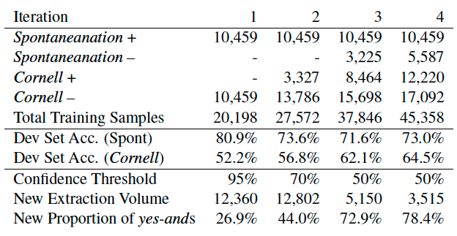
Appendix
Notes:
With each iteration, the trained classifier improves on the average accuracy for the development set (except for the second iteration) and the proportion of new yes-ands increase even with lower confidence thresholds.
Keep this for back up
Instead: more visual representation with concise delivery of the information

Slide 148
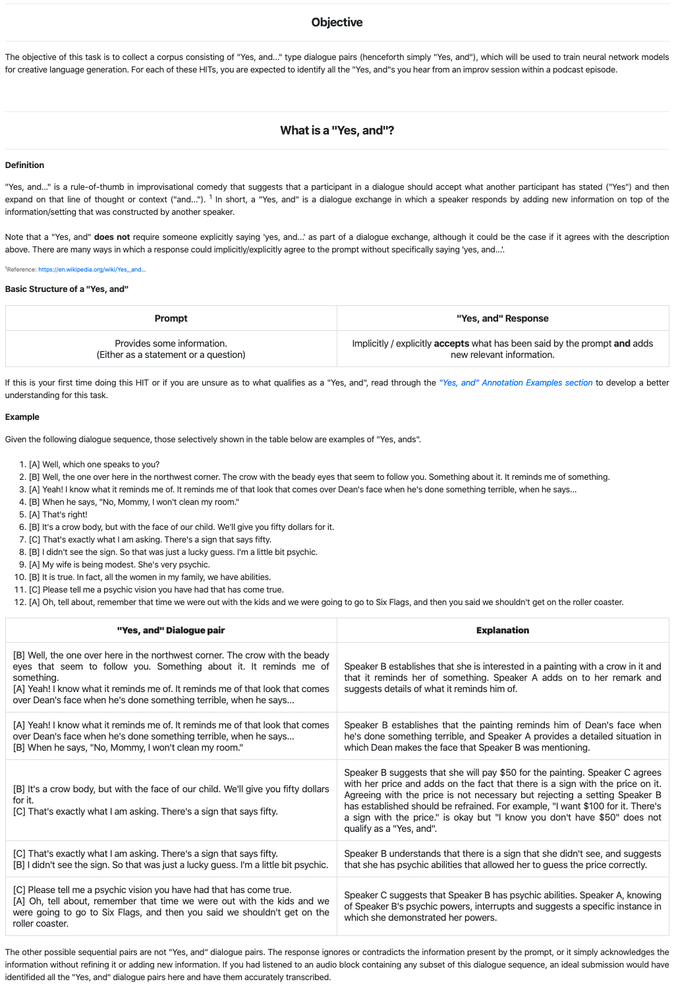
Appendix
Notes:
Show for those interested or to help explain data collection process with turkers.

Slide 149
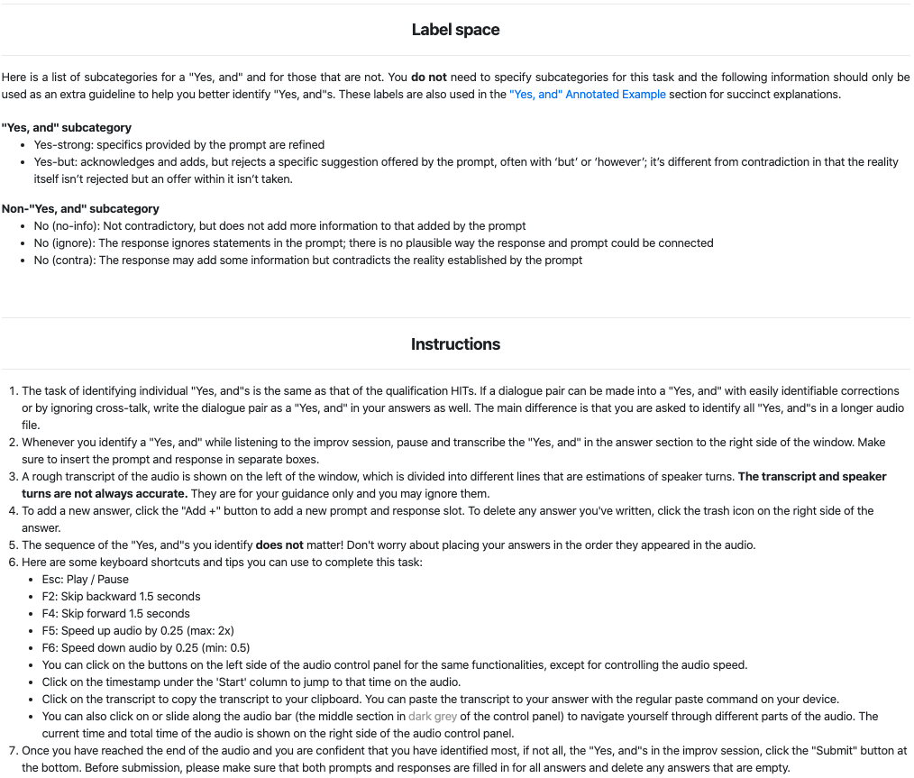
Appendix

Slide 150
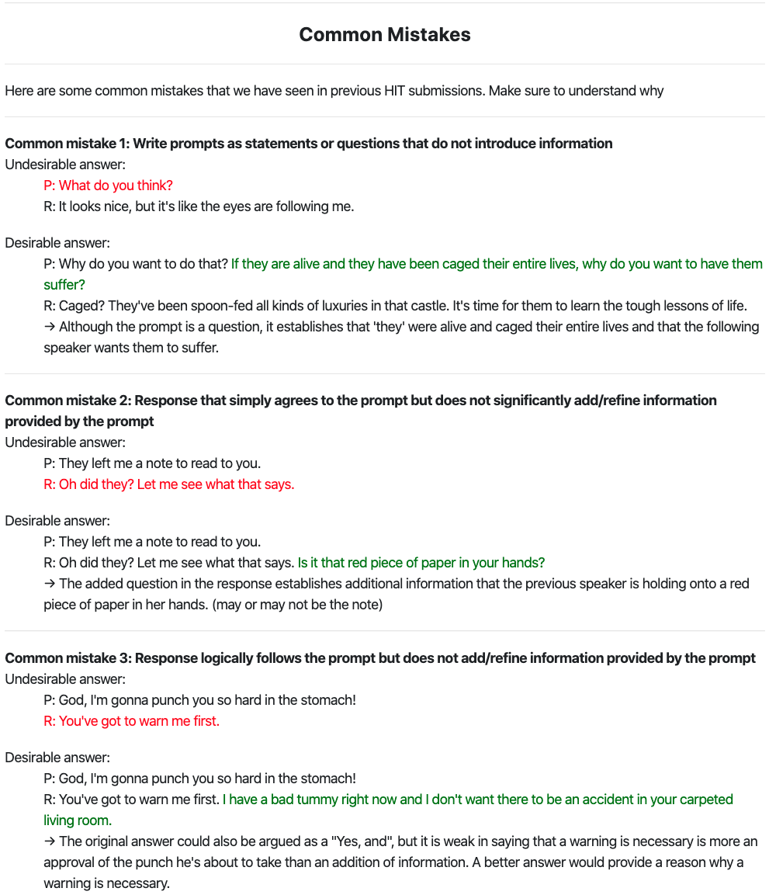
Appendix

Slide 151
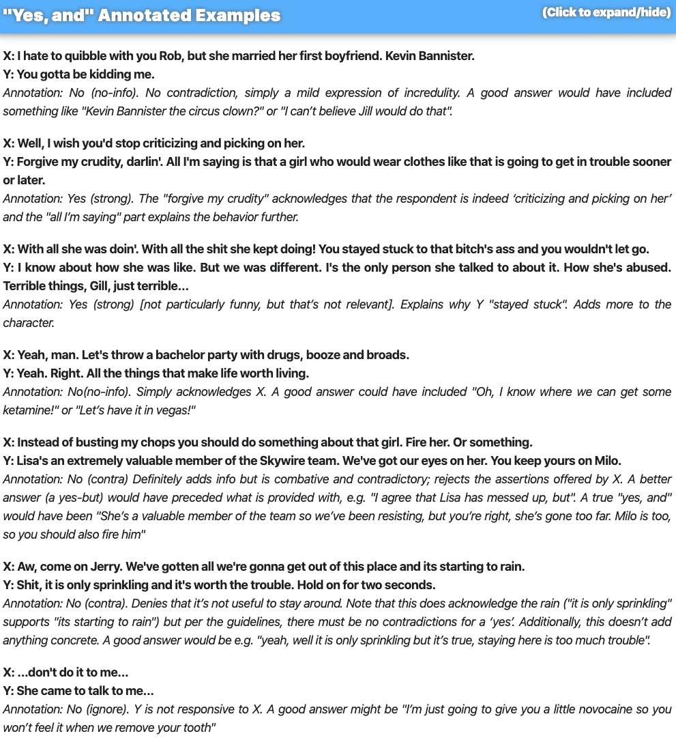
Appendix

Slide 152
Chatbots: pro and con
Pro:
Fun
Applications to counseling
Good for narrow, scriptable applications
Cons:
They don't really understand
Rule-based chatbots are expensive and brittle
IR-based chatbots can only mirror training data
The case of Microsoft Tay
(or, Garbage-in, Garbage-out)
Neural chatbots: seem much better but still don't really understand
The future: combining chatbots with frame-based agents

